Slide 1
ResNet
https://www.youtube.com/watch?v=iBepeakXC08
https://www.youtube.com/watch?v=Uuc1wdqMFtQ
https://www.youtube.com/watch?v=rya-1nX8ktc
https://www.youtube.com/watch?v=mGMpHyiN5lk
https://www.youtube.com/watch?v=5kcM0GbvPSo

Slide 2
Deep Residual Learning for Image Recognition
Deeper neural networks are more difficult to train.
Present a residual learning framework to ease the training of networks that are substantially deeper than those used previously.
Explicitly reformulate the layers as learning residual functions with reference to the layer inputs, instead of learning unreferenced functions.
Provide comprehensive empirical evidence showing that these residual networks are easier to optimize, and can gain accuracy from considerably increased depth.
On the ImageNet dataset evaluate residual nets with a depth of up to 152 layers—8 deeper than VGG nets but still having lower complexity.
An ensemble of these residual nets achieves 3.57% error on the ImageNet test set. This result won the 1st place on the ILSVRC 2015 classification task. We also present analysis
On CIFAR-10 with 100 and 1000 layers.

Slide 3
ResNet50 is a variant of ResNet model which has 48 Convolution layers along with 1 MaxPool and 1 Average Pool layer.
It has 3.8 x 10^9 Floating points operations

Slide 4
Problems
As we know that Deep Convolutional neural networks are really great at identifying low, mid and high level features from the images and stacking more layers generally gives us better accuracy so a question arrises that is getting better model performance as easy as stacking more layers?
With this questions arises the problem of vanishing/exploding gradients those problems were largely handled by many ways and enabled networks with tens of layers to converge but when deep neural networks start to converge we see another problem of the accuracy getting saturated and then degrading rapidly and this was not caused by overfitting as one may guess and adding more layers to a suitable deep model just increased the training error.

Slide 5
Why Resnet ?
Deep networks are hard to train because of vanishing gradient problem.

Slide 6
However, increasing network depth does not work by simply stacking layers together.
Deep networks are hard to train because of the notorious vanishing gradient problem — as the gradient is back-propagated to earlier layers, repeated multiplication may make the gradient extremely small.
As a result, as the network goes deeper, its performance gets saturated or even starts degrading rapidly.

Slide 7
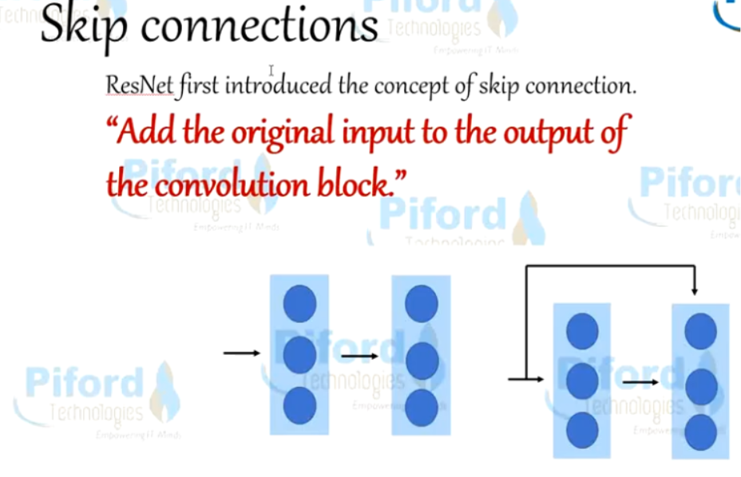
ResNet first introduced the concept of skip connection.
The diagram shown illustrates skip connection.
The figure on the first is stacking convolution layers together one after the other. On the second still stack convolution layers as before but we now also add the original input to the output of the convolution block. This is called skip connection

Slide 8
Why do Skip Connections work?
They mitigate the problem of vanishing gradient by allowing this alternate shortcut path for gradient to flow through
They allow the model to learn an identity function which ensures that the higher layer will perform at least as good as the lower layer, and not worse
Deep residual nets make use of residual blocks to improve the accuracy of the models. The concept of “skip connections,” which lies at the core of the residual blocks, is the strength of this type of neural network.

Slide 19
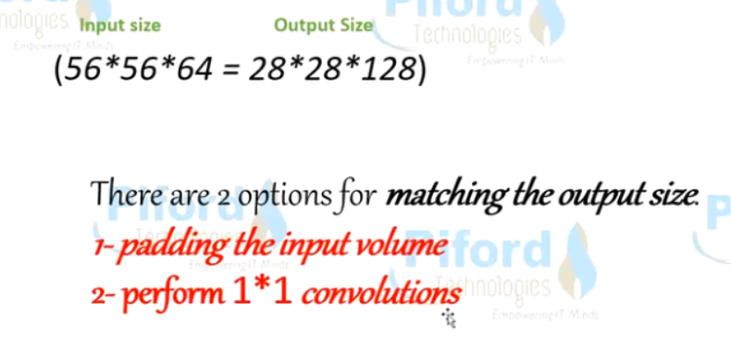
Convolutional Block
The value of ‘x’ is added to the output layer if and only if the If this is not the case, we add a ‘convolutional block’ in the shortcut path to make the input size equal to output size.
There are 2 ways to make the input size equal to the output size -
Padding the input volume,
Performing 1*1 convolutions.

Slide 23
ResNet secured 1st Position in ILSVRC and COCO 2015 competition with just error rate of 3.6% of error rate. (Better than Human Performance !!!)
When deeper networks are able to start converging, a degradation problem has been exposed.
With the network depth increasing, accuracy gets saturated (which might be unsurprising) and then degrades rapidly.
Unexpectedly, such degradation is not caused by overfitting, and adding more layers to a suitably deep model leads to higher training error,

Slide 24
Approach for ResNet
The degradation (of training accuracy) indicates that not all systems are similarly easy to optimize.
Let us consider a shallower architecture and its deeper counterpart that adds more layers onto it.
There exists a solution by construction to the deeper model: the added layers are identity mapping, and the other layers are copied from the learned shallower model.
The existence of this constructed solution indicates that a deeper model should produce no higher training error than its shallower counterpart.
But experiments show that current solvers on hand are unable to find solutions that are comparably good or better than the constructed solution (or unable to do so in feasible time).

Slide 25
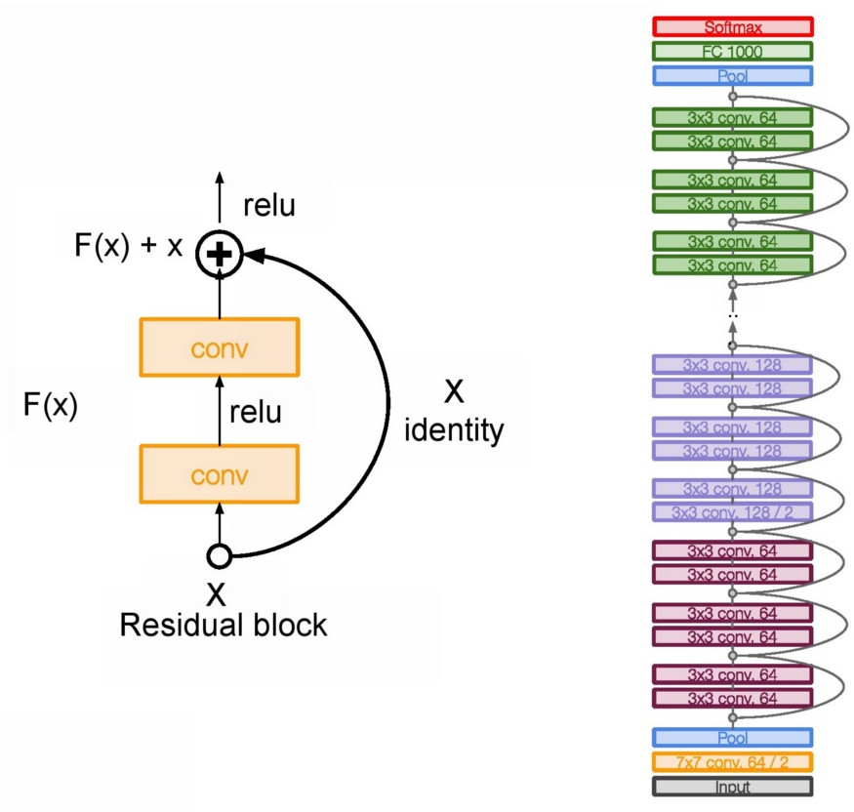
ResNet Architecture and Layer Details

Slide 26
Residual learning: a building block
In this paper, address the degradation problem by introducing a deep residual learning framework.
Instead of hoping each few stacked layers directly fit a desired underlying mapping, here explicitly let these layers fit a residual mapping.
Formally, denoting the desired underlying mapping as H(x), let the stacked nonlinear layers fit another mapping of F(x) := H(x)-x.
The original mapping is recast into F(x)+x.
Hypothesize is easier to optimize the residual mapping than to optimize the original, unreferenced mapping.
To the extreme, if an identity mapping were optimal, it would be easier to push the residual to zero than to fit an identity mapping by a stack of nonlinear layers.

Slide 27
ResNet
Unlike traditional sequential network architectures such as AlexNet, OverFeat, and VGG, ResNet is instead a form of “exotic architecture” that relies on micro-architecture modules (also called “network-in-network architectures”).
The term micro-architecture refers to the set of “building blocks” used to construct the network.
A collection of micro-architecture building blocks (along with your standard CONV, POOL, etc. layers) leads to the macro-architecture (i.e,. the end network itself).
Even though ResNet is much deeper than VGG16 and VGG19, the model size is actually substantially smaller due to the usage of global average pooling rather than fully-connected layers — this reduces the model size down to 102MB for ResNet50.

Slide 28
The formulation of F(x)+x can be realized by feedforward neural networks with “shortcut connections”
Shortcut connections are those skipping one or more layers.
In this case, the shortcut connections simply perform identity mapping, and their outputs are added to the outputs of the stacked layers .
Identity shortcut connections add neither extra parameter nor computational complexity.
The entire network can still be trained end-to-end by SGD with backpropagation, and can be easily implemented using common libraries (e.g., Caffe)

Slide 29
Contribution of ResNet
1) Extremely deep residual nets are easy to optimize, but the counterpart “plain” nets (that simply stack layers) exhibit higher training error when the depth increases.
2) Our deep residual nets can easily enjoy accuracy gains from greatly increased depth, producing results substantially better than previous networks.

Slide 30
ResNet
Won 1st place in the ILSVRC 2015 classification competition with top-5 error rate of 3.57%
There are multiple versions of ResNetXX architectures where ‘XX’ denotes the number of layers.
The basic building block of ResNet is a Residual block which is repeated through out the network.
The core idea of ResNet is introducing a so-called “identity shortcut connection” that skips one or more layers, as shown in the following figure:

Slide 31
What problem does ResNet solve ?
Problem: When deeper networks starts converging, a degradation problem has been exposed: with the network depth increasing, accuracy gets saturated and then degrades rapidly.
Training deep neural networks with gradient based optimizers and learning
methods can cause vanishing and exploding gradients during backprop.
What Resnet enables you to do:
With the help of residual blocks we can increase the number of hidden layers as much as one desires without worrying about the vanishing / exploding gradients problem.
Residual blocks enables the network to preserve what it had learnt previously (if there’s nothing to learn) by having an identity mapping weight function where the output is equal to the input, preserving what the neural network has learnt by not applying diminishing transformations
The residual function creates a duplicate of the given input named as shortcut to preserve the previous output from the possible disastrous transformations.
Conclusion
ResNet will take care of the maximum learning of weights possible without
over-fitting or negative deviation of accuracy through means of vanishing or
exploding gradients problem.

Slide 32
The main base element of ResNet is the residual block.
As we go deeper into the network with a large number of layers, computation becomes more complex.
These layers put on top of each other and every layer try to learn some underlying mapping of the desired function and instead of having these blocks, we try and fit a residual mapping.

Slide 33
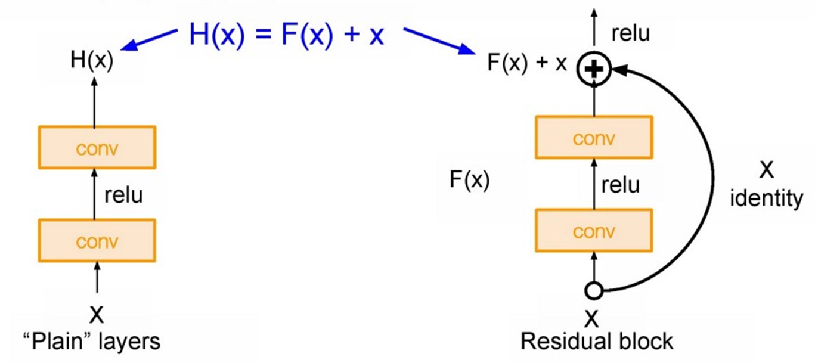
ResNet
The main base element of ResNet is the residual block.
As we go deeper into the network with a large number of layers, computation becomes more complex.
These layers put on top of each other and every layer try to learn some underlying mapping of the desired function and instead of having these blocks, we try and fit a residual mapping.

Slide 34

Here on this right where the input to these blocks is just the input coming in whereas on the other side, we’re going to use our layers to try and fit some residual of our H(X) - X instead of the desired function H(X) directly.
So basically, at the end of this block it takes the skip connection on this right here, where it just takes the input and pass it through as an identity, and so if it had no weight layers in between it was just going to be the identity.
It would be the same thing as the output, but now we use additional weight layers to learn some delta, for some residual from our X.

Slide 35
In nutshell, as we go deeper into the network it is so hard to learn H(X) as we have a large number of layers.
So here we used skip connection and learning F(x) direct input of x as the final output. So F(x) is called as a Residual.
In ResNet, stacks all these blocks together very deeply.
Another thing with this very deep architecture is that it is enabling up to 150 layers deep of this, and then what we do is we stack all these layers periodically.
We also double the number of filters and downsample spatially using stride two. In the end, only fully connected layer 1000 to output classes.

Slide 36
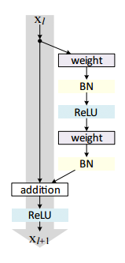
First introduced by He et al. in their 2015 paper, Deep Residual Learning for Image Recognition,
The ResNet architecture has become a seminal work, demonstrating that extremely deep networks can be trained using standard SGD (and a reasonable initialization function) through the use of residual modules:
The residual module in ResNet as originally proposed by He et al. in 2015.

Slide 37
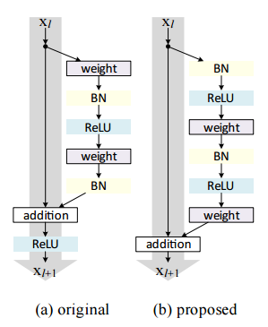
Further accuracy can be obtained by updating the residual module to use identity mappings, as demonstrated in their 2016 followup publication, Identity Mappings in Deep Residual Networks:
(Left) The original residual module. (Right) The updated residual module using pre-activation.

Slide 38
Hyperparameters:
In ResNet, it uses Batch Normalization after every conv layer.
It also uses Xavier initialization with SGD + Momentum.
The learning rate is 0.1 and is divided by 10 as validation error becomes constant.
Moreover, batch-size is 256 and weight decay is 1e-5.
The important part is there is no dropout is used in ResNet.

Slide 39
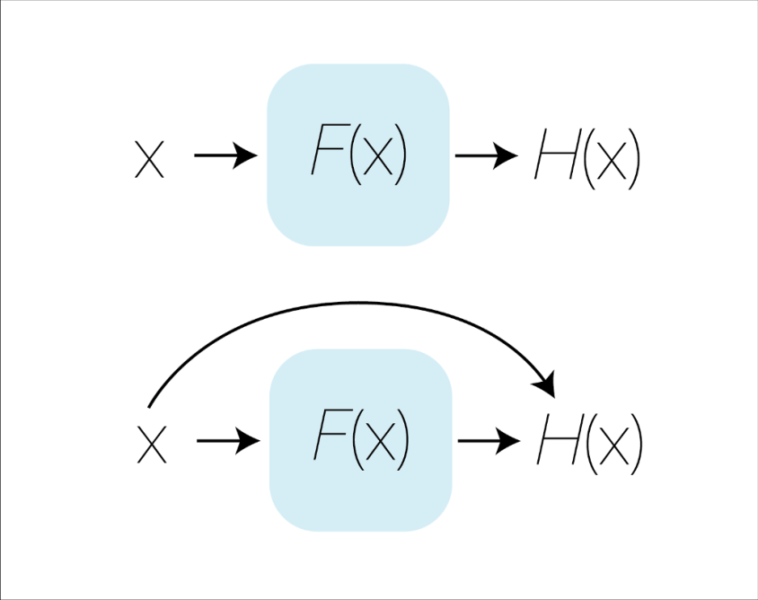
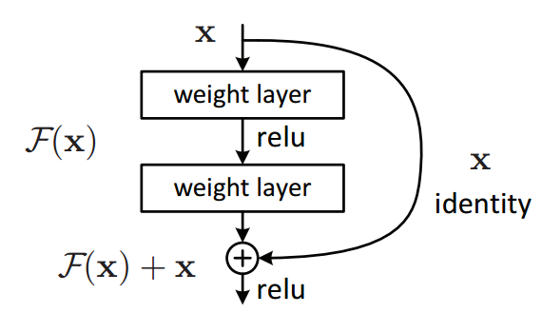
Residual

Slide 40
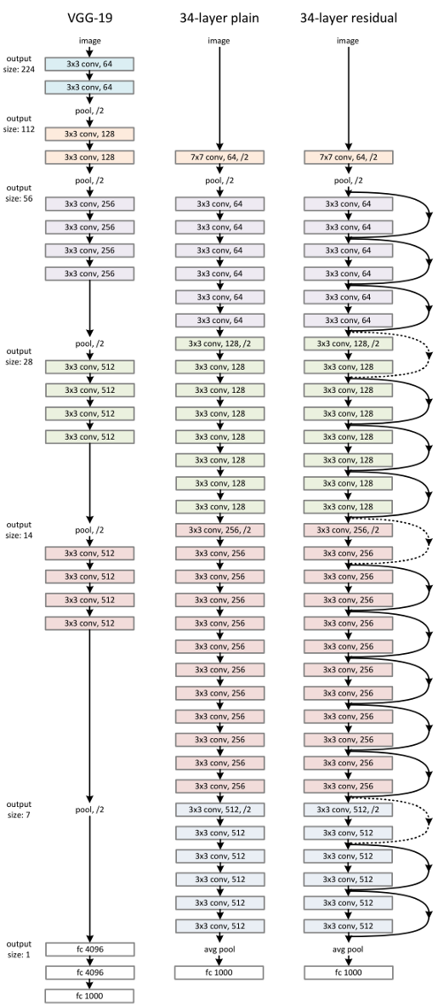
VGG19 34 Layer Plain 34 Layer residual

Slide 41
ResNet architecture makes use of shortcut connections do solve the vanishing gradient problem. The basic building block of ResNet is a Residual block which is repeated through out the network.

Slide 42
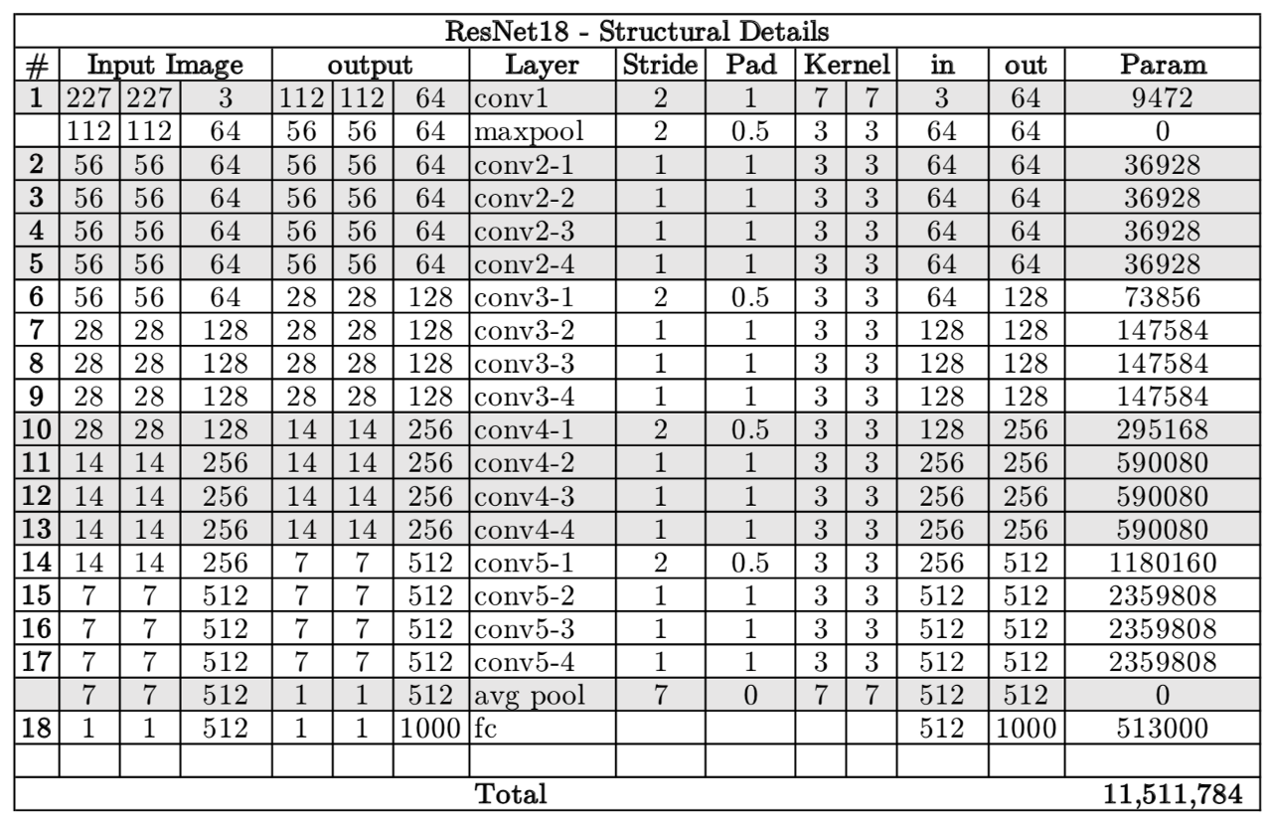
ResNet18

Slide 43
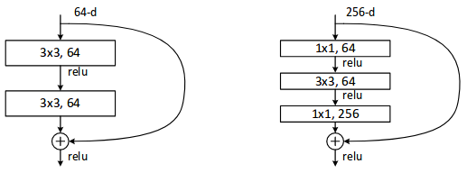
Each ResNet block is either: a. 2 layer deep (Used in small networks like ResNet 18, 34) or b. 3 layer deep( ResNet 50, 101, 152).

Slide 44
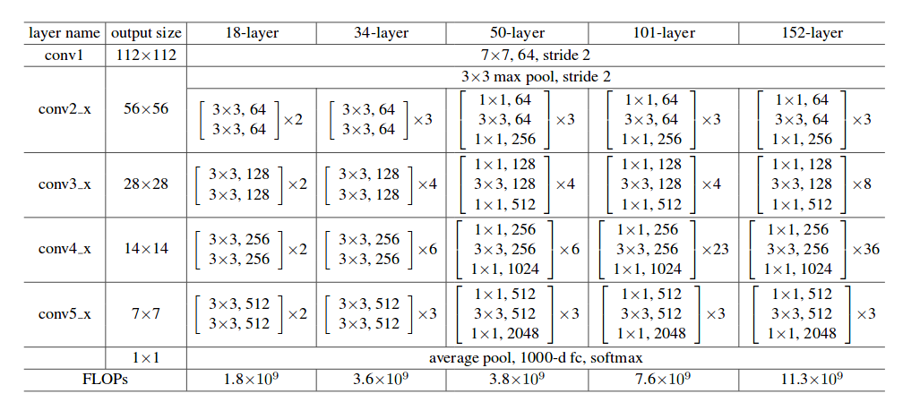
ResNet Architectures

Slide 45
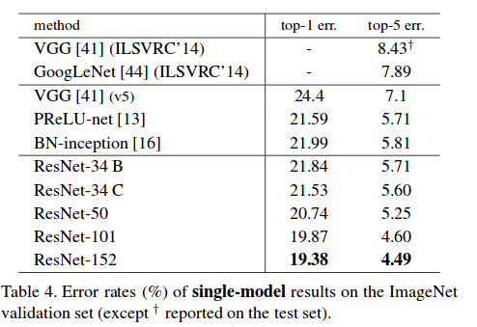
Comparison with VGG

Slide 46
https://github.com/priya-dwivedi/Deep-Learning

